Slide 1
Injection Attacks

Slide 2
Overview…
We are going to look at:
  What is an injection attack?
  SQL Injection
  XSS Attacks
    Stored XSS
    Reflected XSS
  Protection against said attacks

Slide 3
What is an Injection Attack?
An Injection attack is entering code into the system to change the functionality of the system
Adding your own code to the system
Code is injected into the existing system to compromise Confidentiality and Integrity
We will look at three forms of injection attacks:-
  SQL Injection
  Reflected Cross site Scripting
  Stored Cross Site Scripting

Slide 4
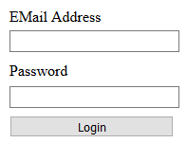
SQL Injection
SQL injection is the process of injecting SQL code to gain access to the database records.
We can also edit, delete and add new records to the database.
So how can we gain access to the DVD Swap Shop?
To authenticate a user, we use a “secure” log in form.
Problem is…without designing it correctly, it can allow for a range of security vulnerabilities.

Slide 5
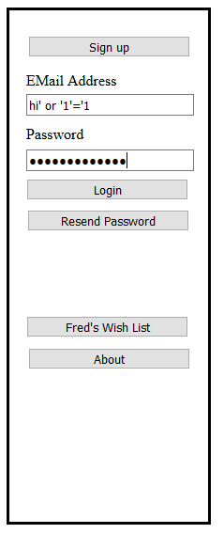
SQL Injection
Lets look at the following:-
  Hi’ or ‘1=1
This piece of text could be what we need to gain access to the system.
So lets use this string within the log in form.
So what does this do?

Slide 6
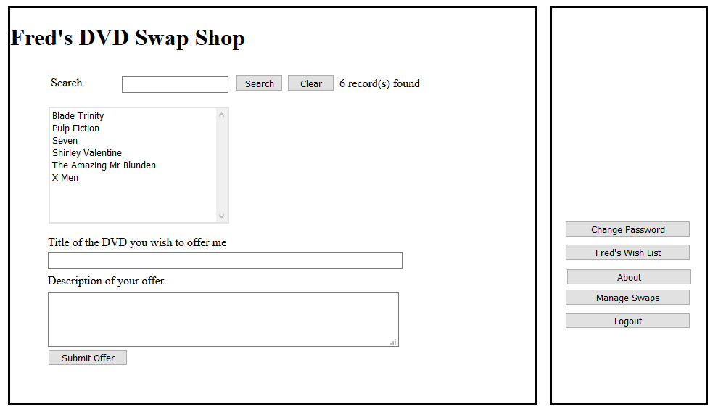

Slide 7
Concatenation
A successful attack relies on a design flaw, that is Concatenated SQL
Concatenation is the process of joining smaller string together to create larger strings
string FirstString = "Hello";
string SecondString = "World";
string ThirdString = FirstString + " " + SecondString;
This creates third made up of both strings with a space

Slide 8
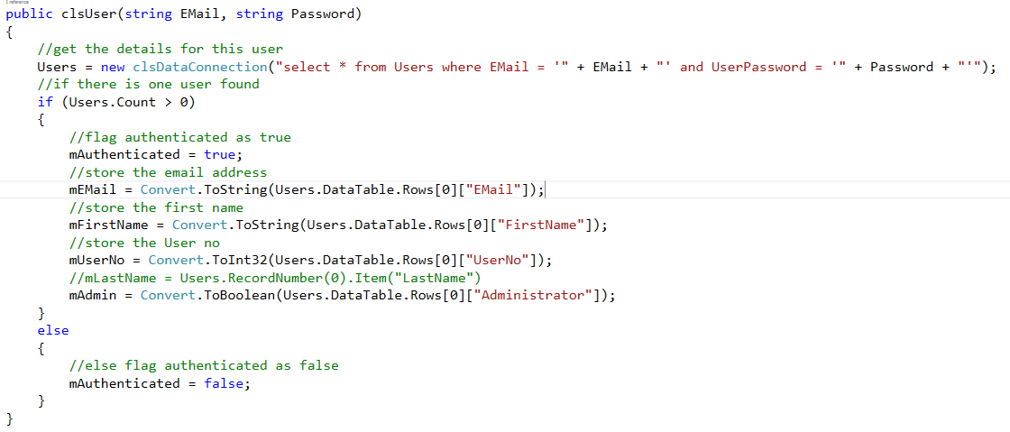
Concatenated SQL
As you probably know, SQL is design to query databases and stands for Structured Query Language
Concatenated SQL is a very common way of developing database systems for the web

Slide 9
What makes it vulnerable?
The section of code that is allowing this SQL injection attack to happen is below
select * from Users where EMail = ‘” + EMail + "' and UserPassword = ‘” + Password + “’”
So lets log in using details…
  Username: mjdean@dmu.ac.uk
  Password: password123
The programming language replaces the key words EMail and Password with the values entered by the user.
select * from Users where EMail = 'mjdean@dmu.ac.uk' and UserPassword = 'password123'"

Slide 10
What makes it vulnerable?
If the login count is greater than zero then details are valid
Lets login using these details…
  Username: hi’ OR ‘1=1
  Password: hi’ OR ‘1=1
  The SQL is then concatenated to form…
select * from Users where EMail = 'hi' or '1'='1' and UserPassword = 'hi' or '1'=‘1’
Because 1 = 1 is always true, the string will return all of the results in the table
As there are more than zero records it logs in as the first user, which in this case is an admin user

Slide 11
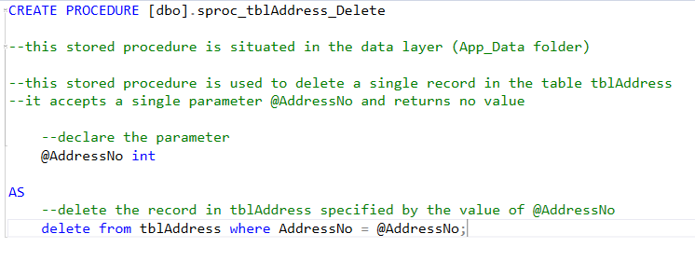
SQL Injection Prevention
Do not use concatenated SQL
Use parameterised stored procedures
You have already used parameterised queries in other modules without knowing its importance
Lets look at IMAT 1604 Visual Web…

Slide 12
SQL Injection Prevention
From looking at the query, you can see that this expects a specific parameter for the query
So instead of concatenating we can call the exact parameter we need
The use of stored procedures adds an extra layer of security but is still open to exploitation with concatenated SQL

Slide 13
Other uses of SQL
There are other uses SQL Injection can do for us….
  Drop Tables
  Update Records
  Insert new records
  Delete records

Slide 14
Cross Site Scripting (XSS)
Cross site scripting is a common vulnerability that allows the injection of code that will perform specific attacks onto the system
There are two forms of XSS attacks
  Stored XSS(Persistent) – Code that is stored on the server and executed on the clients machine. This can be used to send information back to the attacker such as session cookies
  Reflected XSS(Non-Persistent) – Code that executes within a single response. This only impacts users that who open a malicious link or web page. Used in phishing to gain information of the user

Slide 15
Javascript
This is a very common tool to conduct XSS attacks
Runs in the browser
If I can insert javascript, I can force it to run my code on the client
Use this to gain information on the user
  session cookies
  login information
  Add functionality on a malicious attack on the local computer

Slide 16
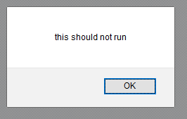
Failed XSS Attack
Let looks at a failed XSS attack…
Using the following code…
  <script>alert(“this must not run!”);</script>
The script tag is standard for html and allows us to add extra functionality to our web pages.
  Responsive menus, scrolling effects or even games.
So what do we get with the above code?

Slide 17
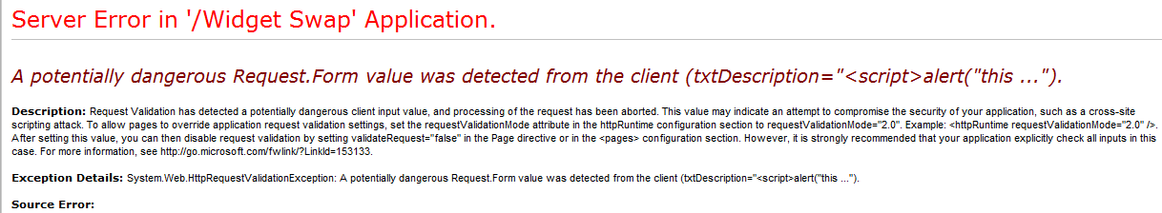
Failed XSS Attack
So if we protected against this kind of attack by having the suitable security settings on
What would we get?

Slide 18
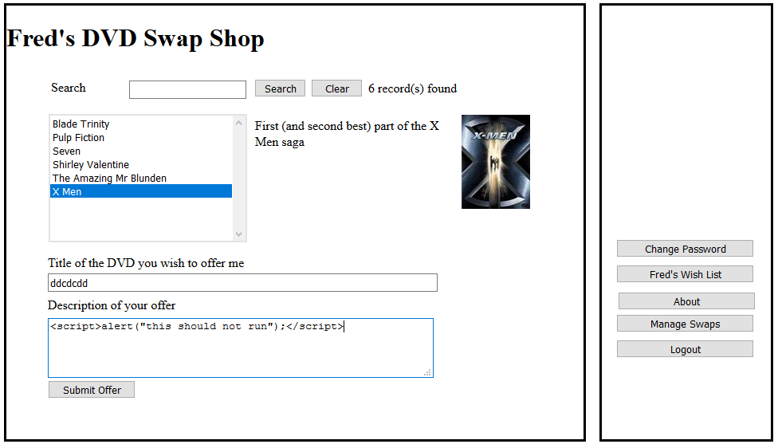
Successful Stored XSS Attack
So what if they weren’t set up correctly?

Slide 19

Successful Stored XSS Attack
After clicking submit we will get a confirmation message….
This is good news for an attacker but bad for a developer
But Why?

Slide 20
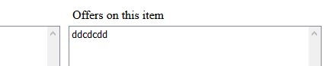
Successful Stored XSS Attack
This kind of attack does not execute straight away as it is not being accessed
However when the user opens the email and views the swap that has been offered…
The display will show a swap called “ddcdcdd”
When the user clicks on this offer the malicious script will execute as its render by the browser

Slide 21
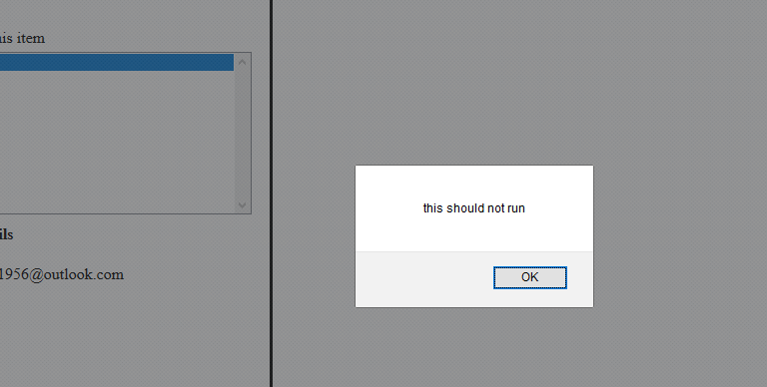

Slide 22
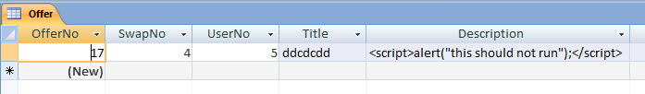
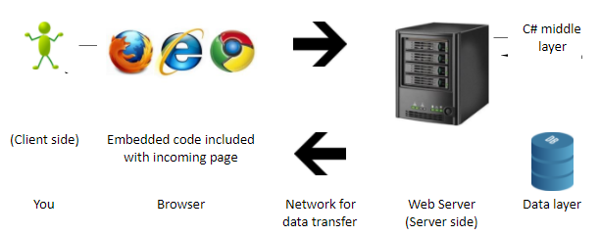
Data Layer Attack
In the database, we will notice that the database entry consists of…
Like a time bomb, the code is waiting to be executed
As script tags are rendered in HTML when executed it displays the alert box and not in plain text on the page

Slide 23
Reflected XSS Attack
Reflected XSS is performed by attaching a malicious script onto the end of a URL
This is a very common attack and have many different possibilities
  Redirect to Phishing
  Stealing cookie information
  Force the user to make an action

Slide 24
Reflected XSS
Compared to a stored XSS attack
This is completed by inserting javascript on the page and making the website carry out specific tasks
As we are already aware by using the command…
  <script>alert(“This is an alert box”)</script>
Gives us a pop up box on screen.

Slide 25
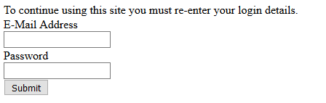
Reflected XSS
Lets look at more complicated techniques…
  Let’s assume there a server called MyEvilServer.com which has a web application called XSSHackSite which contains the following page…
  If we can modify the contents of a div id using the script….
    <script>
    var myText=document.getElementById("Panel1");
    myText.innerHTML = Date();
    </script>
  This will display the date instead of the current content based on the ID.

Slide 26
Reflected XSS
What if we changed that script to a malicious page?
  <script>
  var myText=document.getElementById("Panel1");
  myText.innerHTML = "<a href=http://MyEvilServer.com/XSSDataCapture.html>
  There was a system error please click here to fix it
  </a>";
  </script>
This would change the content of the page and display a link indicating that a problem has occurred and why would a user click the link.

Slide 27
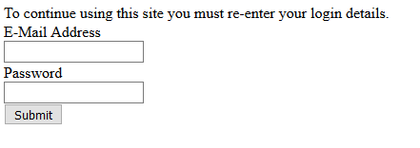
Reflected XSS
Assuming they try to deal with the error they are transferred to the alternate server MyEvilServer.
The attacker has now just got the user name and password for the user.
All of this can be implemented through a not validated and sanitised input field.

Slide 28
Other attacks using XSS
So what else could a XSS be capable of…
  Access to the client computer
  Installation of keyloggers
  Deleting or modification of files on client machines
  Uploading malware

Slide 29
Preventing XSS
Always validate and sanitise inputs to the system
Escape all characters not allowed in system
Give away as little information as possible

Slide 30
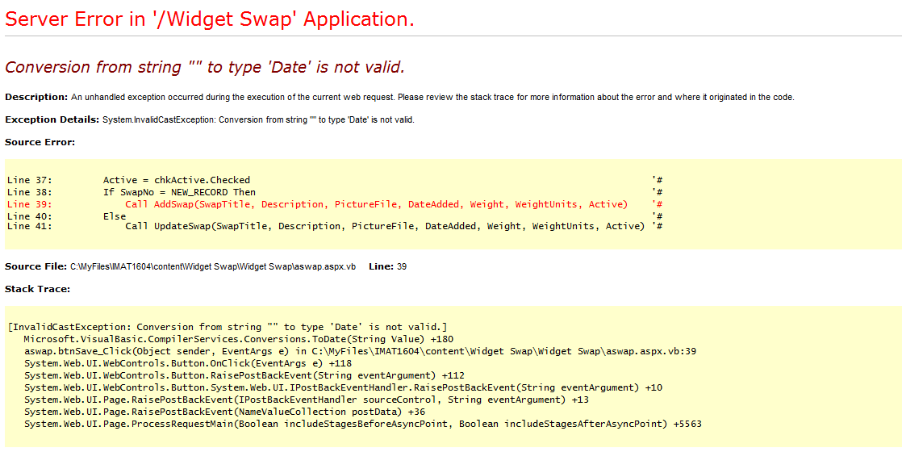
Preventing XSS
Why is this bad?

Slide 31
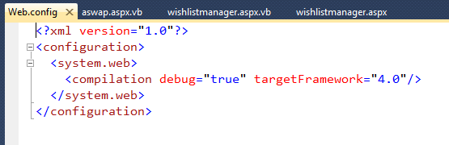
Web.Config
This is an XML file containing configuration information about the website and directories.
Default for Visual Studio is for debugging to be turned on.

Slide 32
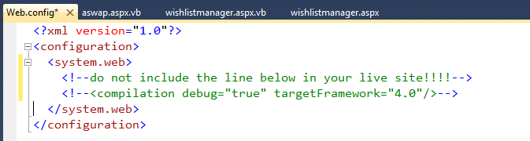
Web.Config
This makes sense as debuggers need to see the errors
When deploying the application the web.config file needs modifying…

Slide 33
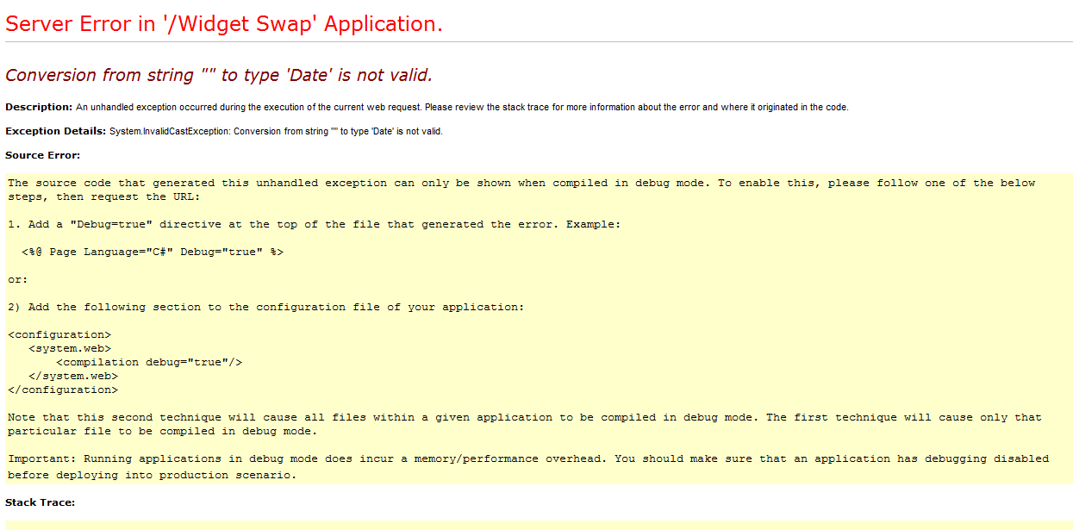
Web.Config
When the system crashed the user sees the following error message

Slide 34
Web.Config
This is where most of security configurations are switched on and off
The default is for them to be turned on but don’t automatically assume this is the case – check!

Slide 35
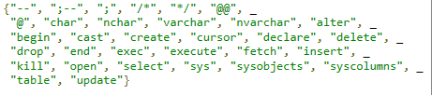
Validation
Since vulnerabilities can exist in any of the layers. Its wise to validate all data as it passes between each layer.
Exclude Lists – Examines data passed around each layer looking for anything suspicious.
If any data consists of the exclude key words then we can reject or modify it to make it safe.
Problem is we have to think of everything the hack may do.
We can also use an include list which allows certain data instead of excluding.

Slide 36
Recap…
We have looked at:
  What is an injection attack?
  SQL Injection
  XSS Attacks
    Stored XSS
    Reflected XSS
  Protection against said attacks.
To look into more security risks to web applications then look at:
  https://www.owasp.org/index.php/Category:OWASP_Top_Ten_2017_Project

